Slide 1
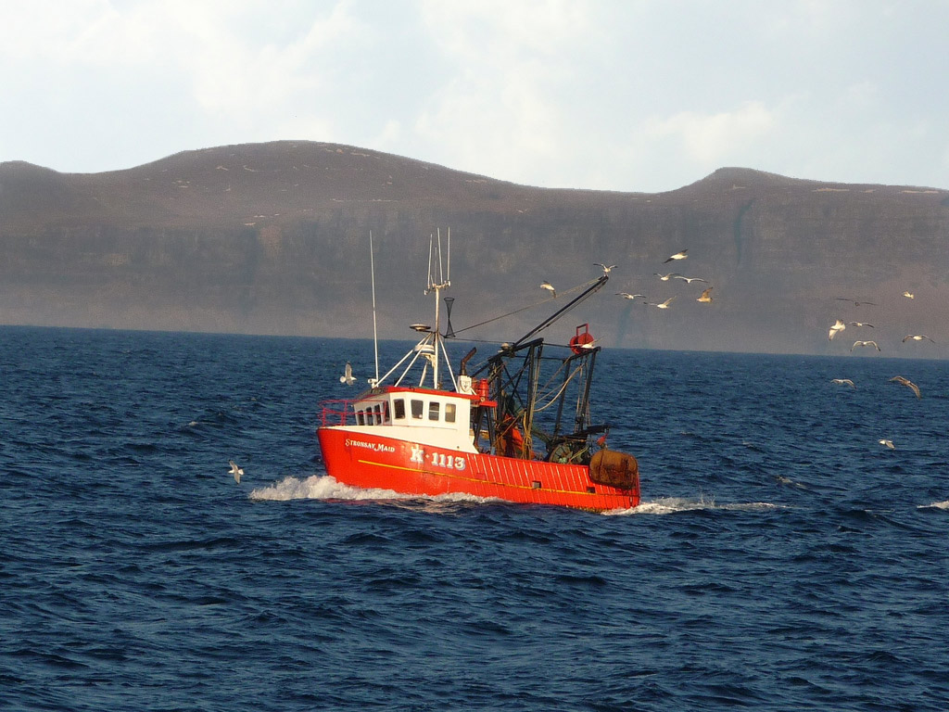
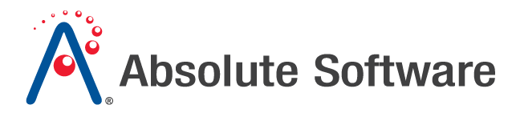
Fisheries Solutions
Fisheries Solutions
© 2011 Absolute Software Inc, All Rights Reserved. All Trademarks Acknowledged.

Slide 2
Absolute Fisheries Solutions
Fisheries Monitoring Systems were first introduced in the late 1990s in an effort to combat Illegal, Unreported and Unregulated fishing (IUU). The technology is today used in most major fisheries markets worldwide, monitoring over 25,000 fishing vessels
The legal basis is the United Nations Convention on the Law of the Seas (UNCLOS). The Convention provides Coastal States with primary responsibility for managing all marine resources located within their 200 nautical mile Exclusive Economic Zone (EEZ)
There is also increasing use of Fisheries Solutions to monitor high-seas fishing beyond EEZ limits, under cooperative agreements by member states forming Regional Fisheries Management Organizations (RFMOs). This relies on members authorizing importation and sale of catch only if caught in accordance with certain conditions (fishstock traceability)
Absolute offers a full range of Fisheries Solutions, including:
  Vessel Monitoring Systems (VMS)
  Electronic Catch Reporting
  Quota Management Systems
  Fishstock Traceability Reporting
  Catch Documentation Systems
Notes:
System Architecture Overview

Slide 3
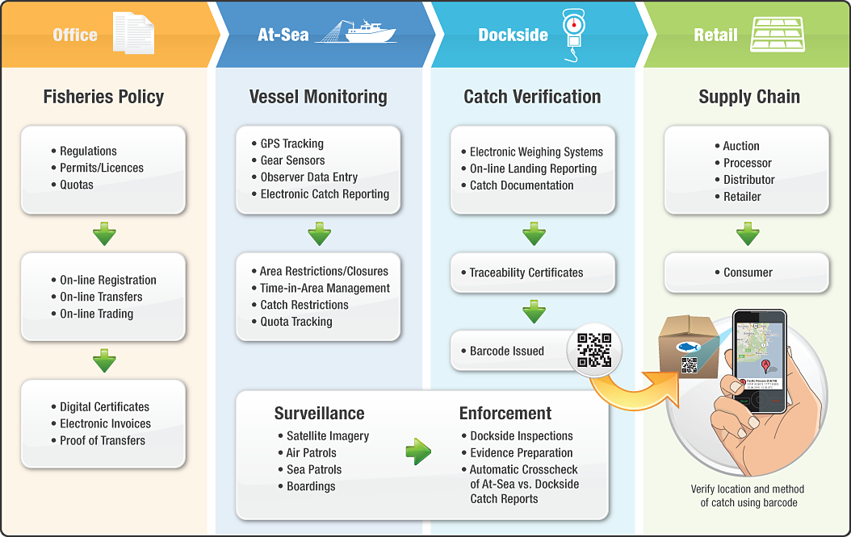
Absolute Fisheries Solutions – from Ocean to Dinner Plate

Slide 4
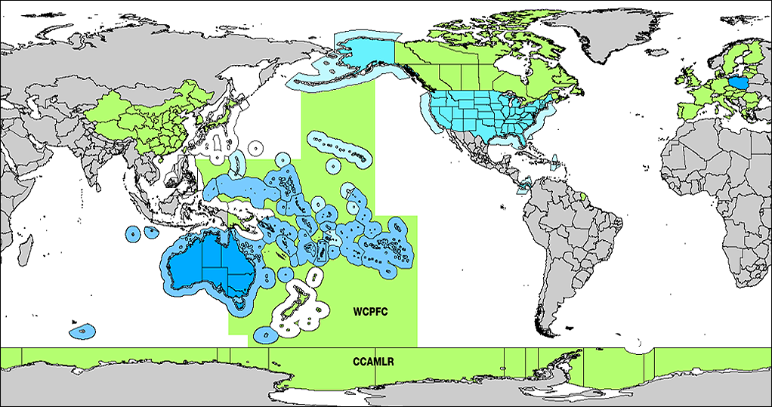
Absolute Fisheries Solutions – Used Worldwide
Absolute has been active in this market since 1998, and today supplies Fisheries Solutions to over 35 countries and territories worldwide.
We have offices in the United States, Australia, Thailand and Panama supporting clients on a 24x7 basis with the monitoring of over 30M NM² of ocean, as shown below:
Full Absolute Solution
Electronic Logbooks
High-seas Monitoring (for Flag)

Slide 5
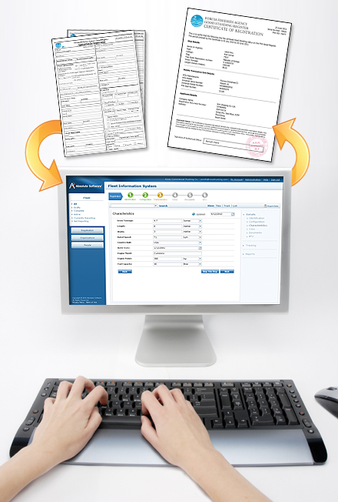
The Fleet Information System
Absolute’s flagship product is now the leading
web-based solution for fisheries management
Support for all Key Stakeholders
Issue Certificates/Permits/Licenses
Issue/Track/Trade Quota Entitlements
Case Study: FFA Good Standing Register

Slide 6
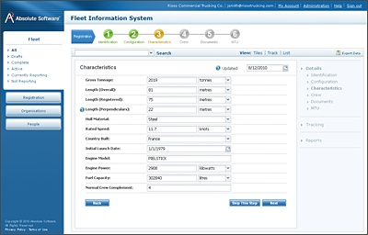
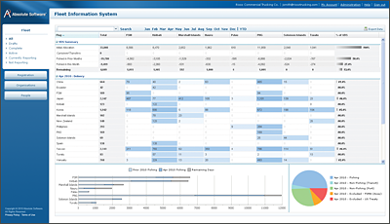
Support for all Key Stakeholders
Fisheries Management Organizations
(tracking, vessel details, photos and licenses)
License/Permit Holders
(providing electronic registration, catch reporting, catch documentation, quota trading, on-line licensing and exemptions)
Vessel Owners, Agents and Charterers
(secure access to their own fleet of vessels)
Search & Rescue Organizations
(provides track data for SURPIC requests)
International Organizations (data sharing)
(built-in features allow data sharing under regional fisheries management programs including European, Pacific and Antarctic XML/NAF based data exchange formats)
The Fleet Information System

Slide 7
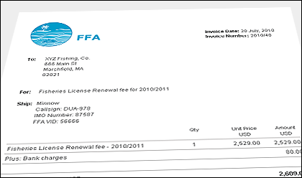
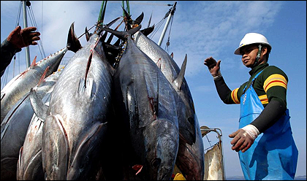
Issue Digital Certificates/Licenses/Permits
The Fleet Information System includes a secure web-based Vessel Registration System
(accessed online by Shipowners/Operators)
Supports customization to match the specific requirements of each fisheries program
(at a fraction of the cost of a custom system)
Modules include:
Registration of Vessel Details
(gear configuration, callsign, name etc)
Registration of Organization Details
(DUNS number, address etc)
Captain/fishing master/crew details
Billing and Invoicing (of licensing fees)
Document scanning, uploading and versioning
Approval workflows within the fisheries agency
Generates License/Quota/Permit Certificates
(as digitally signed PDF format files)

Slide 8
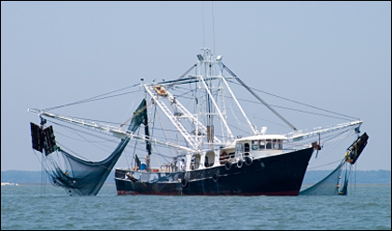

Issue/Track/Trade Quota Entitlements
Quota Management is an additional component of the Fleet Information System
(this involves customization for each fishery – but at a substantially lower cost than developing a quota management system in-house)
The key advantage of combining Quota within the Fleet Information is that the following data collection has already taken place:
Vessel & Owner Registration
Permits/License Issuance
GPS tracking data (VMS)
Reported Catch (via electronic logbooks)
Quota are supported both on input and output controls, including:
Declared Activity (a declaration system)
Day-at-Sea / Vessel-Day Schemes
Catch Limits (by day, trip, season)
Quota transfers/trading/leasing

Slide 9

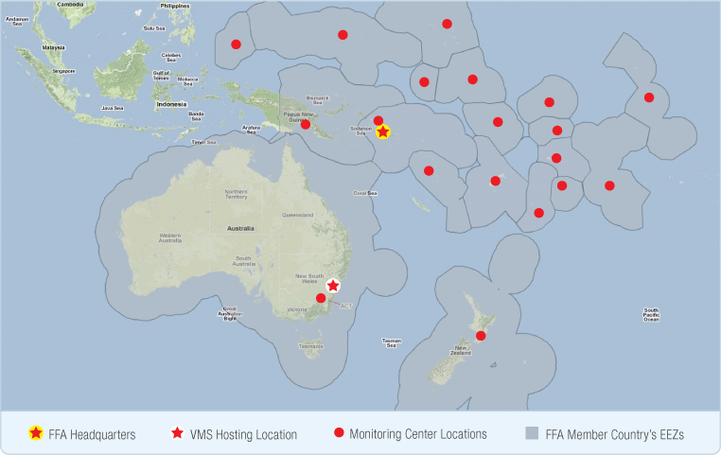
Case Study
The FFA Good Standing Register
The Pacific Islands Forum Fisheries Agency (FFA) covers over 30 million square miles of fishing territories, and operates as a joint surveillance and monitoring center tracking over 3,800 vessels for 17 countries. The Fleet Information System provides FFA with an online ship-registration process, access to VMS monitoring data and calculates the time-in-area for each vessel operating under under a Vessel Day Scheme.
FFA Member Countries
Australia*
Cook Islands
Federated States
of Micronesia
Fiji
Kiribati
Papua New Guinea*
Nauru
New Zealand*
Niue
Palau
Marshall Islands
Samoa
Solomon Islands
Tokelau
Tonga
Tuvalu
Vanuatu
* Excluding vessels within own EEZ

Slide 10
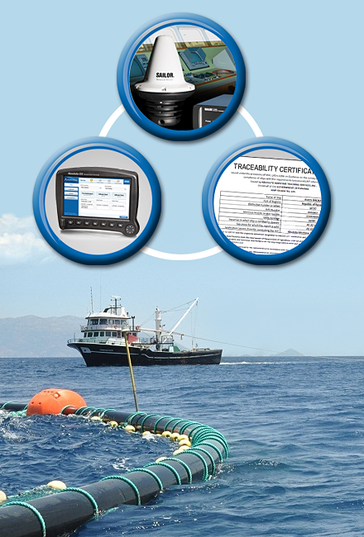
Vessel Monitoring Systems
Absolute supports the widest range of Vessel Monitoring System (VMS) shipboard equipment
Hardware Comparison Chart
Type Approval Process
Satellite Service Providers
Global Coverage
Fishing Gear & Engine Sensors
Illegal, Unregulated, Unreported Fishing
(the use of Satellite Radar & Meteorological Data)

Slide 11
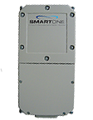
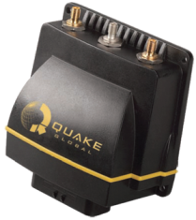
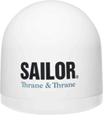

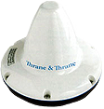
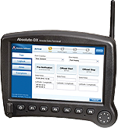
Comparison of Vessel Monitoring Hardware
 | Globalstar | IsatM2M | Inmarsat-C | Iridium SBD | Fleet Broadband DTS
GPS Tracking | X | X | X | X | X
Two-way Communication |  | X | X | X | X
Electronic Forms |  | X | X | X | X
E-mail (without attachments) |  |  | X | X | X
Full Email/Web Access |  |  |  |  | X
Approximate Base Price per Vessel | $400 | $800 | $1,500 | $1,000 | $6,000
add Absolute Electronic Logbook (E-Forms) | (not supported) | +$1,500 | +$1,500 | +$1,500 | +$1,500

Slide 12
Type Approval Process
Type Approval is necessary to identify which VMS hardware is suitable for a specific fishery
Technical (bench) and environmental (at-sea) trials are recommended in all cases. This formal testing process ensures VMS hardware is suitable for it’s intended use in an evidentiary capacity
VMS equipment is often the target of tampering and interference:
  Properly configured VMS hardware is highly resistant to tampering
  In contrast generic ‘tracking’ devices are less secure and can be easily compromised
  Improper scripting/configuration/installer passwords can also compromise VMS hardware
  All hardware products recommended by Absolute for VMS use include strong security features
Absolute has extensive experience assisting with Type Approval procedures including:
  The Federal Register Notices setting out standards for United States Type Approval
  (Enhanced Mobile Transceiver Regulations published by NOAA)
  The South Pacific Forum Fisheries Agency VMS Type Approval
  (applicable in 16 countries within the Pacific region)
High quality documentation for installation procedures is critical. We recommend that the installation process incorporate tamper-evident security stickers, script/security configurations to harden the VMS equipment; and an annual inspection to verify compliance
Notes:
System Architecture Overview

Slide 13




Satellite Service Providers
Inmarsat is an internationally recognized pioneer in the satellite communication industry. The Inmarsat-C network is widely used for VMS, and provides GPS tracking, email and safety services (via the Global Maritime Distress Safety System). Vizada and Stratos provide Inmarsat airtime to Absolute Software.
Iridium is the world’s only truly global mobile satellite communications company. Iridium is particularly suited to VMS applications requiring a high number of electronic forms and/or for coverage at high latitudes (>70°). Absolute is an authorized Iridium Value Added Reseller.
SkyWave Mobile Communications provides satellite data communication products and network services to enable low-cost and dependable security and remote management of mobile and fixed assets. Operating on the Inmarsat IsatM2M network, the DMR range of products is ideal for VMS on small to midsize vessels.
Globalstar offers specialized simplex data products to send GPS information from remote locations. These devices are small form factor, low-power devices. Ideal for covert installation and particularly suited to small fishing boats, this option is suited to even the smallest artisanal fishing vessels.

Slide 14
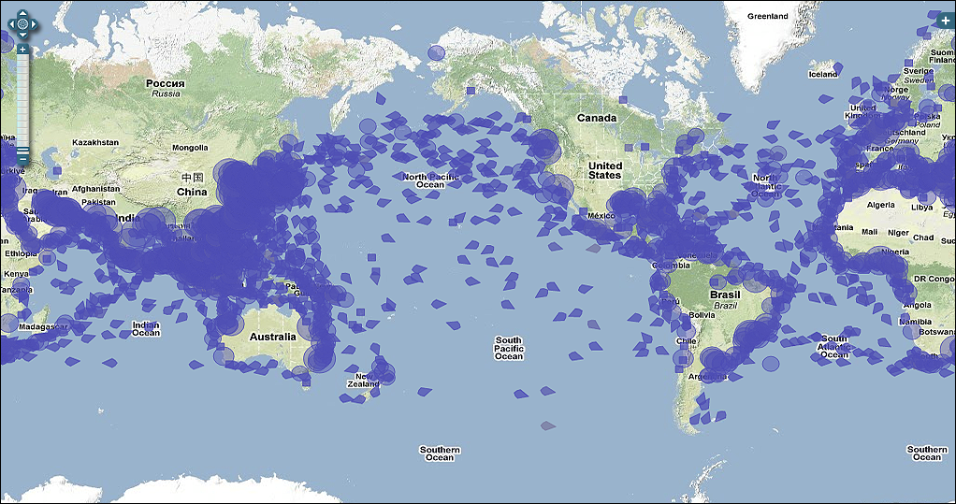
Absolute Fisheries Solutions offer Global Coverage
An estimated 55,000 vessels report today via the communications providers shown – including both Fisheries VMS and Merchant Maritime LRIT systems.
Over 12,000 of these vessels are monitored by Absolute, in areas that span over over 90 countries and territories worldwide (shown below):

Slide 15
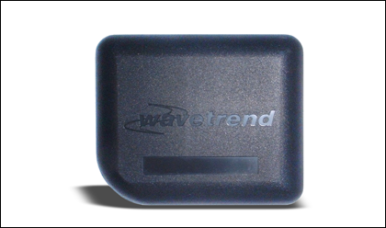
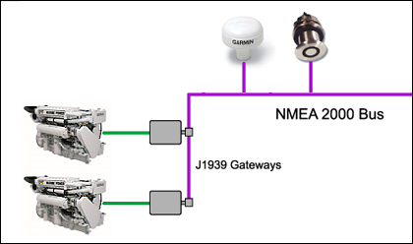
Fishing Gear & Engine Sensors
With increasing sophistication of VMS hardware it is now possible to capture sensor data along with GPS location and time information
Available options include:
  J1939 Engine Data
  (engine RPM, fuel consumption data)
  NMEA-2000 data
  (depth soundings, speed-over-water)
  Analog sensors; attached to winch drums and
  hydraulic lines to monitor gear deployment and
  retraction
Additional options on Fleet Broadband and Iridium OpenPort:
  Realtime GPS data (<1 minute resolution)
  Slow frame rate video capture
  Enhanced Gear Sensor Resolution
  RFID tag readers

Slide 16
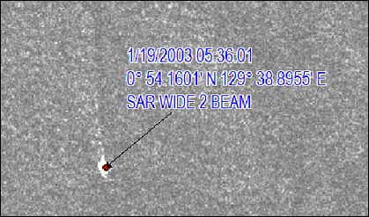
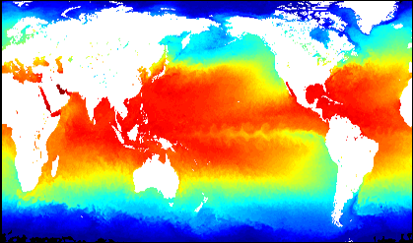
Illegal, Unregulated and Unreported Fishing
VMS provides an overview of known vessels – those with permits/licenses and transmitting position information
IUU detection, using Satellite Radar, helps to identify potential hotspots for illegal fishing and VMS non-reporting by:
Estimating the total vessel count in area
Matching all known vessels to VMS
Identifying approximate size ranges and count
of unknown vessels; i.e. <10m, 10-20m, >20m
Meteorological Data provides a further indication of the most active areas for Highly Migratory Species
The combination of these two technologies enables precisely targeted deployment of surveillance assets

Slide 17
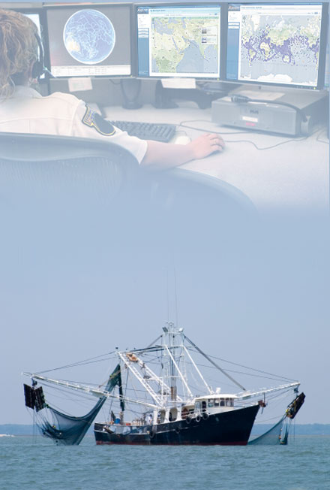
Fisheries Monitoring Center
Custom built consoles and monitoring centers for use in fisheries surveillance applications
Monitoring, Control and Surveillance
Performance, Security and Reliability
Fisheries Intelligence and Surveillance
Remote Access Options
Training and Certification
Search & Rescue and Counter-Piracy
Prosecution and Legal Support
Case Study: Australian Fisheries

Slide 18
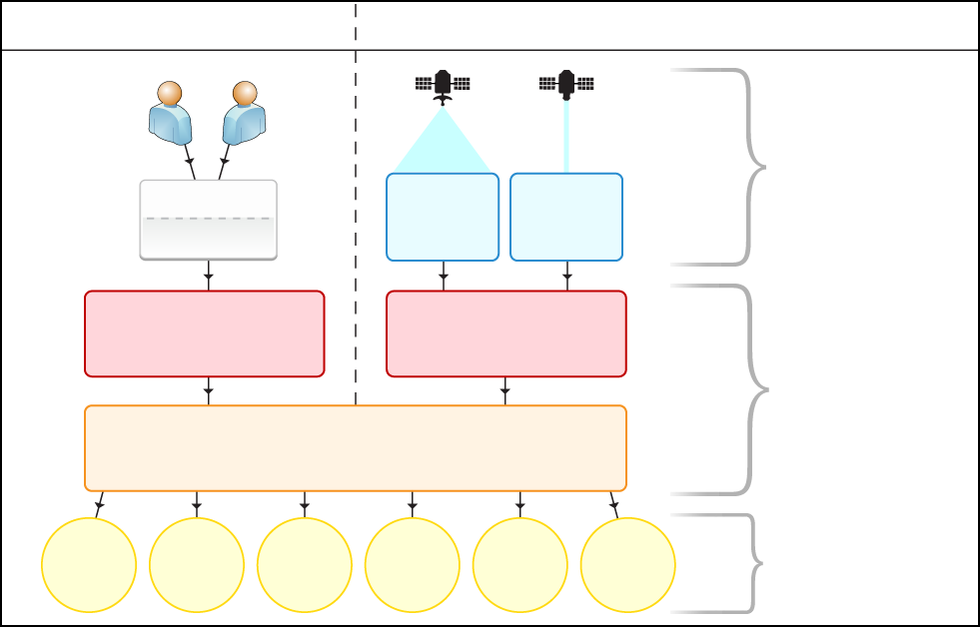
Overview of the Fisheries Monitoring Center
Vessels with VMS
IUU Vessels (no VMS fitted)
Captain
Observer
Ship
E-Forms
GPS Tracking
Ocean &
Meteorological
Data
Synthetic
Aperture
Radar
Communication
Service Providers
Data
Providers
Fisheries
Monitoring Center
The Fleet Information System
Licensing
Permits
Search & Rescue
Fisheries Science
Quota
Mngmt
Enforcement
Legal
Users
Notes:
System Architecture Overview

Slide 19
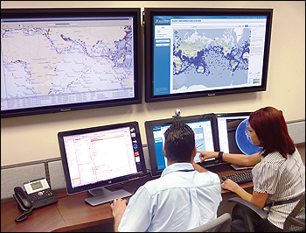
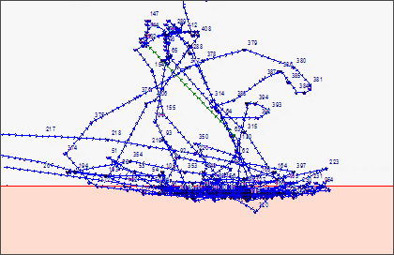
Monitoring, Control and Surveillance
We design, build and operate Monitoring, Control and Surveillance (MCS) consoles
Our combined display integrates Vessel Monitoring, Electronic Logbooks, Licensing and IUU detection capabilities
Absolute’s largest MCS center is manned on a 24 x 7 basis, 365 days a year, monitoring over 6,000 vessels
We also provide real-time support to flag administrations and multinational forces engaged in combating piracy
Measured System Availability | 99.67%
Number of 24 x 7 Duty Officers | 6
Search & Rescue Positions Sent | 9,000+
Realtime Piracy Alert Responses | 15+
Closed Area 4A

Slide 20
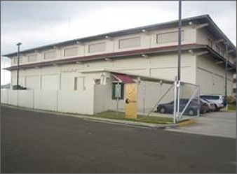
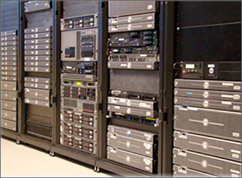
Performance, Security and Reliability
The Operations Center processes position & catch reports, within a high availability environment suitable for the collection, storage and forwarding of evidentiary data
Absolute operates three server clusters for redundancy (The United States, Australia and Panama). Fault tolerance is achieved through the use of replicated HP Servers, EMC Storage, VMWare Virtualization and Sonicwall firewalls
For customers who prefer to deploy in-house (using their own infrastructure) we provide reference implementations under VMWare. This enables fully virtualized hosting within a client’s own datacenter environment
Vessels Tracked Daily | 12,000+
Countries VMS data is shared with | 40+
Countries LRIT data is shared with | 25+
Total Position Reports Daily | 40,000+

Slide 21
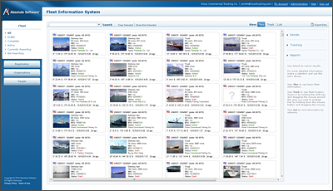
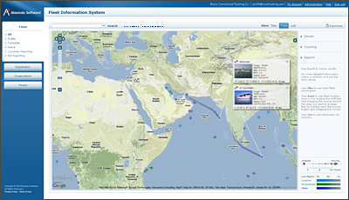
Fisheries Intelligence & Surveillance Tools
Absolute provides the most complete Web Based Surveillance toolkit. Features include:
  Ship Registration, License, Photos
  GPS Position Reporting (VMS)
  Catch Reporting / Electronic Logbooks
  Vessel Day Schemes & Trip Reporting
  Full text search and export of all data
  (formats include XML, CSV, Google Earth)
2D and 3D visualization tools provide an integrated view of the ship’s activity, location and past voyages
Alarms and Notifications include:
  Entry/Exit to defined or restricted areas
  Unexpected slowdown at-sea (trans-shipment)
  Faulty or non-reporting VMS Equipment
  Failure to transmit catch reports
  VMS Tamper detection
The Fleet Information System

Slide 22
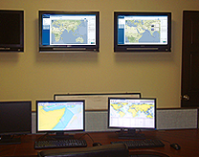
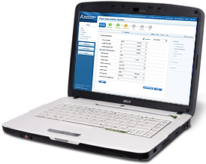
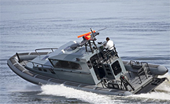
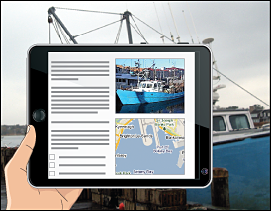
Remote Access Options
Monitoring Consoles
Field Agents & Operators
Custom designed monitoring centers
Secure web-based access (SSL encrypted)
Patrol Craft
Portable Access
Fleet Broadband or Iridium OpenPort
Tablet optimized for 3G/4G

Slide 23

Training & Certification
Absolute has teamed with The Australian National Centre for Ocean Resources and Security (ANCORS) to provide training and advice on vessel tracking. ANCORS is Australia’s only multidisciplinary university-based centre dedicated to research, education and training on ocean law, maritime security and natural marine resource management.
Training Includes:
• Satellite tracking and how it works
• Satellite communications:
• The Global Position System (GPS):
- How GPS works
- GPS in the context of vessel tracking
• Mobile Transceiver Types (MTU)
• Inspection of MTU's on board vessels
• Type Approval/Conformance Testing
• Hands on training
• Interpretation of track data
• International law in the context of
vessel tracking
• National law in the context of vessel tracking
• Evidence Requirements/ Gathering
• Real world examples
• Court procedure
• Mock Court
ANCORS - University of Wollongong, Australia

Slide 24
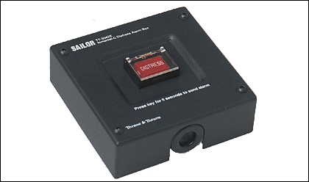
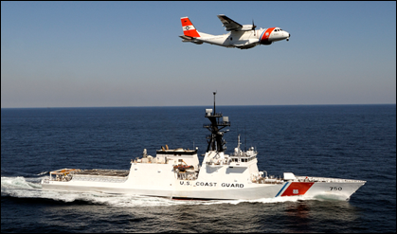
Search & Rescue and Counter-Piracy
  We have a proven track record of providing reliable data for Search & Rescue and Anti-Piracy operations
  Hardware is compatible with SOLAS/GMDSS (Inmarsat-C equipment only)
  Our system fully supports the requirements of the IMO mandated Ship Security Alert System for SOLAS class shipping, including a fully staffed 24x7 monitoring center
  VMS data is made available in a variety of C2/C4 tactical formats for coastguard and navy agencies, the most common being the NATO OTH-GOLD format

Slide 25
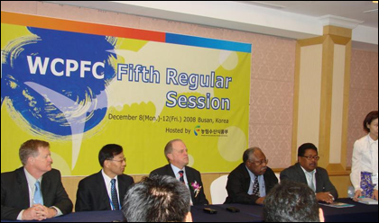

Prosecution and Legal Support
We offer a full range of assistance in the regulatory, prosecution and legal aspects of operating a Vessel Monitoring System
Services provided include:
  Assistance in drafting VMS regulations
  Expert analysis and testimony
  Preparation of custom reports for
  evidentiary use (i.e. case packages)
  Attendance as technical experts at
  international bodies; including the United
  Nationals Food & Agriculture Organization
  and International Maritime Organization
Our staff have over 40 years combined experience in fisheries enforcement, including both the commercial and government aspects of operating Fisheries Monitoring systems

Slide 26

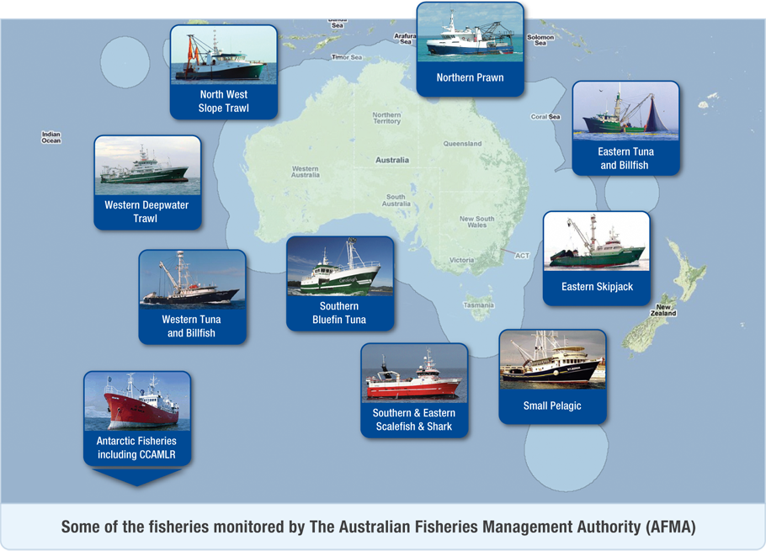
Case Study
Managing Over 52,000 Tonnes of Catch Annually
AFMA provides professional observer services to domestic and foreign fishing vessels operating within the Australian Fishing Zone (AFZ), including sub-Antarctic territories and waters controlled under the Commission for the Conservation of Antarctic and Marine Living Resources (CCAMLR).

Slide 27
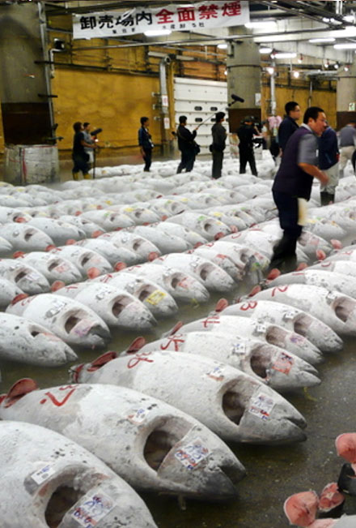
Promoting Sustainable Fishing
Catch Verification
Electronic Catch Logbooks
Customizable Electronic Forms
Fisheries Science
Supply Chain
Case Study: NOAA Electronic Logbooks

Slide 28
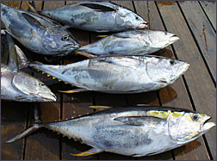
Catch Verification
Catch reporting takes place both at-sea, though electronic reporting systems, and upon landing with the submission of dealer, agent or action house.
Many agencies today require a form of landing report, but this information is often delayed in receipt and is not well integrated with other systems.
The Fleet Information System provides a single system that can load and convert data from both at-sea and at-dock landing reports - making it available immediately for port inspection personnel via 3G/4G handheld tablets.
Our systems are designed to meet the traceability
requirements being introduced by the EU, North
American and Japanese authorities.

Slide 29
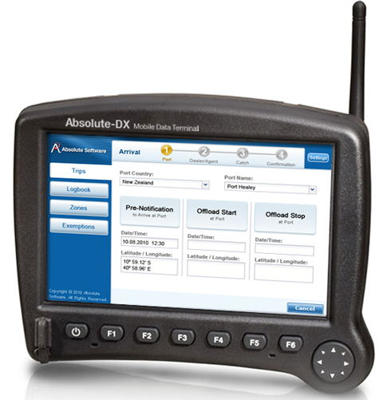
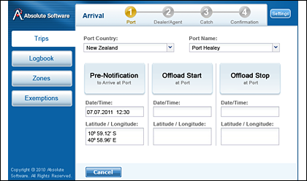
Electronic Catch Logbooks
Electronic Forms are used for data entry on-board by either a vessel captain, fishing master, or independent observer
Electronic Forms are also known as:
  Electronic Logbooks
  Electronic Catch Reporting Systems
Absolute offers one of the most widely deployed electronic reporting platforms with over 2,000 vessels currently using our e-form technology
Absolute’s systems operate at a fraction of the cost of some other systems, through the use of advanced compression technology
We promote open standards for data sharing. This enables a single device to meet the requirements of multiple fisheries authorities simultaneously

Slide 30
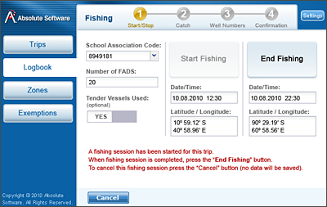
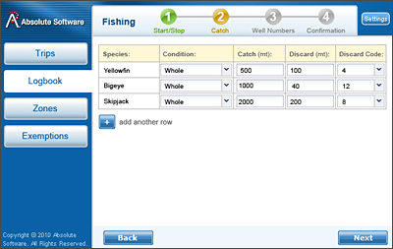
Customizable Electronic Forms Templates
Absolute has a library of over 50 fisheries e-forms, which we use as a basis for new fisheries programs. These form types include:
  Trawl-by-Trawl Catch reporting
  Daily Catch Logs
  Transshipment, Disposal and Landing
  Declaration of Activity (Days-at-Sea)
  Requests for Exemptions or Waivers
  Pre-Landing Notifications
Fisheries regulations change over time. Our e-forms solutions accommodate this with remote updates (via the VMS equipment). In contrast, other solutions often require a USB stick or CD be mailed to each vessel, which is no easy task in practice
We support PIN codes and hardware code devices for added security and authentication

Slide 31
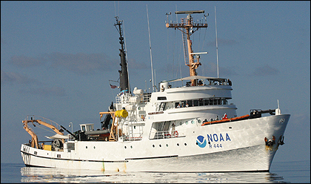
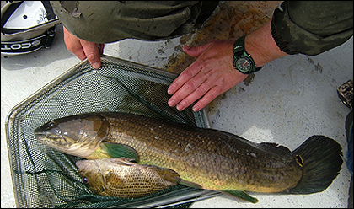
Fisheries Science
The Fleet Information System provides a high quality source for correlated location (GPS), catch (e-forms from vessel operators and observers) and environmental data (sensors)
Absolute has extensive experience with processing data into formats that can be easily integrated into fishstock and environmental impact assessment programs
The Fleet Information System has a range of geospatial tools to prepare data for incorporation into scientific data products, including:
Position data sorted by Statistical Area
Catch/Effort data matched with VMS activity
Estimates of fishing vs. transit activity
(based on speed & course variations)
Port-to-port trip recording

Slide 32
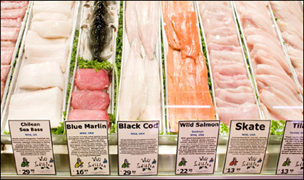
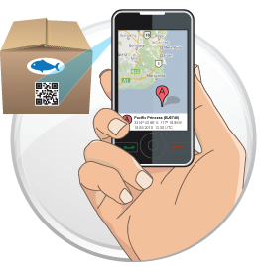
Supply Chain
Absolute’s efforts to extend Fishstock Traceability towards the consumer are a work-in-progress, in close cooperation with fishing operators, government regulators and technology suppliers.
Absolute is in a unique position to assist - technology for issuing digitally signed traceability certificates is a core feature of the Fleet Information System.
2D barcodes are printed on catch certificates, and may then be scanned or reprinted at all points in the supply chain; i.e. dealer, wholesaler, retailer
Basic information is available from the 2D barcode. Sensitive Information, such as the exact location of catch, is available only to authorized parties via secure web logon

Slide 33

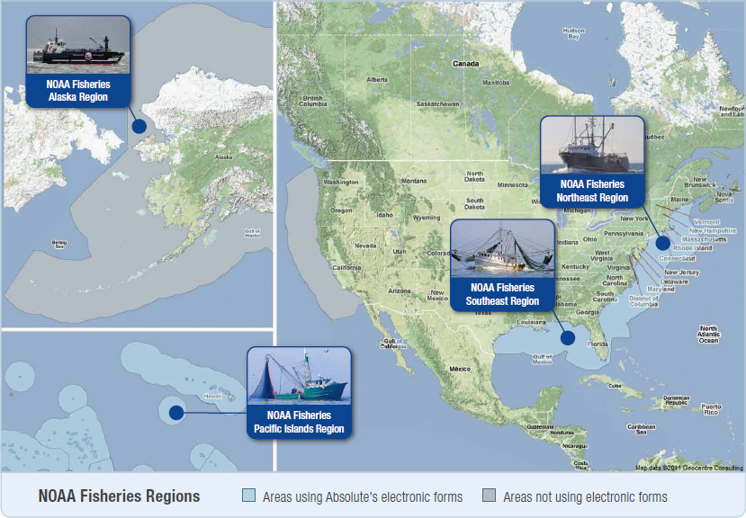
Case Study
Electronic Logbooks installed on over 2,000 Ships
Today over 2,000 vessels use Absolute's electronic forms technology to report their catch activities to fisheries authorities - in real-time via a Vessel Monitoring System (VMS) terminal fitted on-board each vessel.

Slide 34
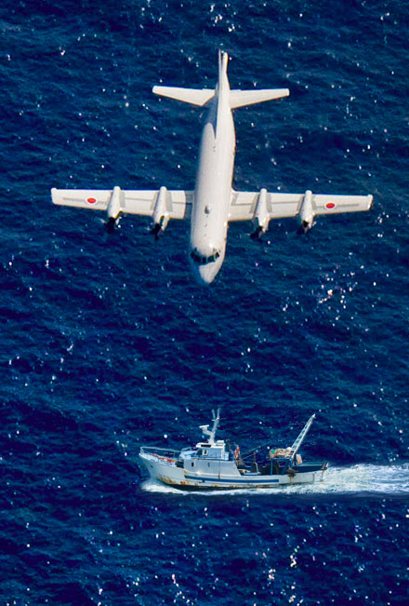
Maritime Domain Awareness
Fisheries Management within the context of
Maritime Security, AIS and the LRIT System
Related Systems
  Automatic Identification System (AIS)
  Long Range Identification & Tracking (LRIT)
  Vessel Monitoring System (VMS)
  Satellite Virtual Private Networks (VPN)
Case Study:
Panama Maritime Authority

Slide 35

Maritime Domain Awareness – Integrating VMS, LRIT and AIS

Slide 36



Case Study
Panama Maritime Authority LRIT
World’s Largest National Data Center:
  Over 7,000 ships monitored under the IMO
  Long-range Identification & Tracking System
  Supports Inmarsat-C, IsatM2M, Iridium
  Fully fault tolerant severs
  (Panama and Boston)
Maritime Security & Counter-Piracy:
  Real-time coordination (NATO and EU
  taskforces)
  OTH-GOLD and IMO-XML data formats
Services for Shipowners:
  LRIT Conformance Testing
  Shipowner Fleet Tracking
IMO Secretary General Inaugurates Panama Surveillance Center - 2011

Slide 37
Thank You
For further information please contact us at: sales@absolutesw.com
North American Office
Absolute Software, Inc.
19th Floor
101 Federal Street
Boston, MA 02110
United States
Tel: + 1 617 800-9367
Asia/Pacific Office
Absolute Software, Inc.
Level 9, Zuellig House Building
1 Silom Road,
Kwaeng Silom, Khet Bangrak,
Bangkok 10500 Thailand
Tel: +66 2231-8249
Panama Office
Absolute Maritime Tracking Services, S.A.
City of Knowledge, No 221
Panama, Republic of Panama
Tel: +507 301-5748
Australian Office
Absolute Software PTC
Level 36 Riparian Plaza
71 Eagle Street
Brisbane QLD 4000
Australia
Tel: +61 7 3121-3079
Visit us online at: www.absolutesw.com

