Slide 1


Vehicle & Cargo Monitoring
© 2011 Absolute Software Inc, All Rights Reserved. All Trademarks Acknowledged.

Slide 2

Vehicle Hardware Options
Overview
Iridium & GSM
Inmarsat IsatM2M
Globalstar
Mobile Data Terminals

Slide 3
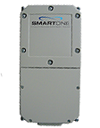
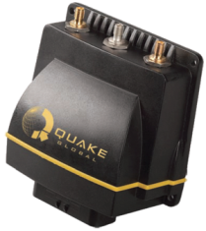

Hardware Options
Features | Globalstar | IsatM2M | Iridium + GSM
GPS Tracking & Digital Inputs | ✔ | ✔ | ✔
Two-way communication & SCADA |  | ✔ | ✔
Driver Logs, Timesheets & Reports |  |  | ✔
Engine Diagnostics (J1939/CANBus) |  |  | ✔
Email and SMS |  |  | ✔
Full Email and Web Access |  |  | GSM Only
Base Price per Vehicle | $300 | $800 | $1,000
add Mobile Data Terminal | (not supported) | +$1,500 | +$1,500

Slide 4
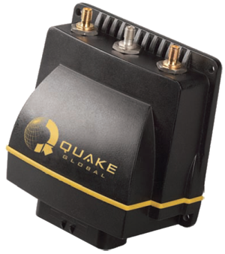
Quake Q-PRO – Iridium
The Quake Q-PRO transceiver offers GPS tracking, telemetry and engine diagnostics.
Operating on the Iridium SBD and GSM cellular networks, the Quake Q-PRO Mobile Transceiver Unit (MTU) combines an integrated intelligent GPS, with on-board firmware housed in a tamper resistant enclosure. With custom script capability, this is our most configurable and programmable option for any application.
Features
Satellite Networks | Iridium, GSM
Data Rate/Protocol | 2.4kbps (SBD), 144kbps (GPRS)
Power | 9-32 VDC, 3W max (tx)
Backup Power | External
Tamper Resistance Level | Level 3 (Iridium Doppler position)
GPS | 50 Channel Integrated
Size and Weight | 119 mm x 119 mm, 3.9kg
Sensors | 3 Serial RS-232C , J1939 CAN Bus
Environment | -40 to +85°C, J1455 & IP67 rated
Hardware/Firmware Features
Timed & Event Reporting
SCADA/Telemetry Control Functions
Driver Panic Button
Geofence Entry/Exit
Change of Speed (over/under speed)
Other
Logfile (positions) | >50,000
Remotely update scripts | Yes
Retrieve position log remotely | Yes

Slide 5
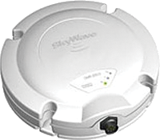
DMR 800 – Inmarsat M2M
The DMR 800L a compact, lower power consumption option.
The DMR-800L features an integrated GPS and Inmarsat antenna mounted in a low-profile enclosure. Popular for semi-covert fitments, or cargo tracking this option is the most cost effective when used for event based reporting (i.e. on refrigerated containers), where some level of remote control is needed to change parameters.
Features
Satellite Network | Inmarsat
Data Rate/Protocol | 0.2kbps, TDMA
Power | 9-32 VDC, 12W max (tx)
Backup Power | External
Tamper resistant level | Level 2 (GPS jamming detection)
GPS | 16 Channel Integrated
Size and Weight | 160 mm x 97 mm, 0.8 kg
Sensors | 4 digital I/O, Serial (RS-232)
Environment | -40 to +85°C, Antenna IP67 rated
Hardware/Firmware Features
Timed & Event Reporting
SCADA/Telemetry Control Functions
Driver Panic Button
Geofence Entry/Exit
Change of Speed (over/under speed)
Other
Logfile (positions) | >15,000
Remotely update scripts | Yes
Retrieve position log remotely | Yes

Slide 6
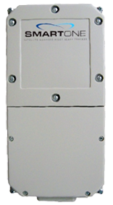
SMARTONE – Globalstar
The SMARTONE is our smallest, lightest and lowest cost option.
This unit features an integrated GPS and Globalstar antenna with internal battery. A one-way transmitting device, this unit is pre-configured to report on movement and/or other events at intervals from 15 minute to 1 hour. Installation is very straightforward (no antenna or power cabling required). It is ideal for covert or temporary fitments such as monitoring unpowered cargo and containers
Features
Satellite Network | Globalstar
Protocol | Simplex Data Service (SDS)
Power | 9 - 30 VDC
Backup Power | Internal 4xAA batteries (90 days)
Tamper resistant level | Level 1
GPS | 12 Channel Integrated
Size and Weight | 165 mm x 82 mm, 70 g
Sensors | 2 digital inputs
Environment | -30 to +60°C, IP67, Intrinsically Safe
Hardware/Firmware Features
Timed & Event Reporting
SCADA/Telemetry Control Functions
Driver Panic Button
Geofence Entry/Exit
Change of Speed (movement)
Other
Logfile (positions) | No
Remotely update scripts | No
Retrieve position log remotely | No

Slide 7
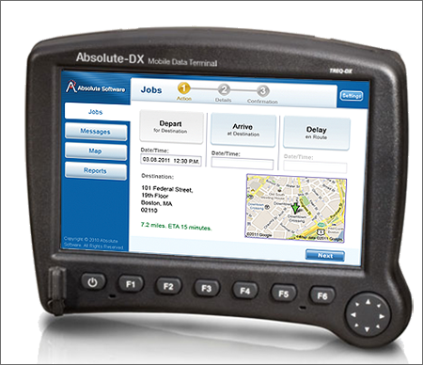
Absolute-DX – Mobile Data Terminal
Messaging and Driver Logbook.
Provides real-time driver job dispatch, driver timekeeping (logbooks), SMS messaging and configurable reports
• 800x480 pixel, 178 mm (7”) color TFT LCD display
• Analog resistive touch screen
• Seven backlit function keys for common operations
• Serial port (connects to serial VMS equipment)
• Ethernet (connects to Fleet Broadband VMS equipment)
• Two USB ports (keyboard, mouse or trackball)
• Four additional Digital I/Os
• Windows® CE 5.0 operating system
• AMD Geode™ GX 500 (x86) processor
• 128MB RAM, 2GB Flash Hard Drive
• 8 to 32 VDC power range
• -20 to +60°C operating temperature
• Day/Night Mode Switch
• RoHS compliant, CE certified, FCC approved

Slide 8
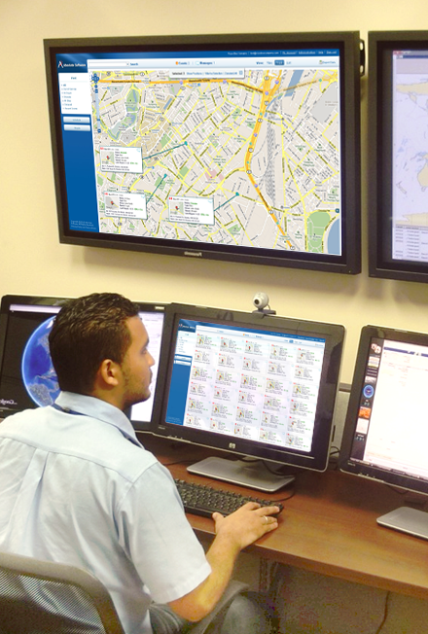
The Fleet Information System
Overview of Capabilities
User Interface
  Fleet Alarms and Messages
  Mapping, Tracking and Routing
Cloud Services and Hosting

Slide 9
Overview of Capabilities
• GPS Tracking
• Geographic Information System (GIS)
• Google® Maps Integration
• 2D and 3D visualization tools
• Full text search
• Alerts, Alarms and Notifications
• Custom Overlays (polygons)
• Entry/Exit Alerts
• Over/Under Speed Alerts
• Application Programming Interface (API)
for integration with in-house systems
• Active Radio Frequency Identification
(RFID) for Cargo Monitoring
• J1939 (CANbus) Engine Diagnostics
(speed, breaking, temperature)
• Shortest Distance/Time Routing
(Google Maps and Traffic integration)
• Fleet Maintenance Reporting
(mileage, time-by-state/country)
• Driver Security Features (panic button,
SMS messaging)
• Remote Monitoring (SCADA)
• Graphs of Digital and Analog sensors
• Job Dispatching

Slide 10
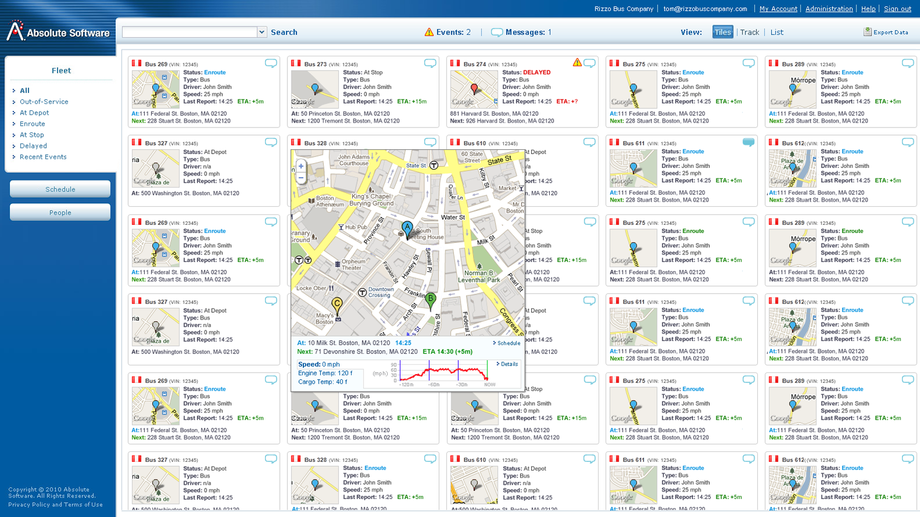
Fleet Alarms and Messages

Slide 11
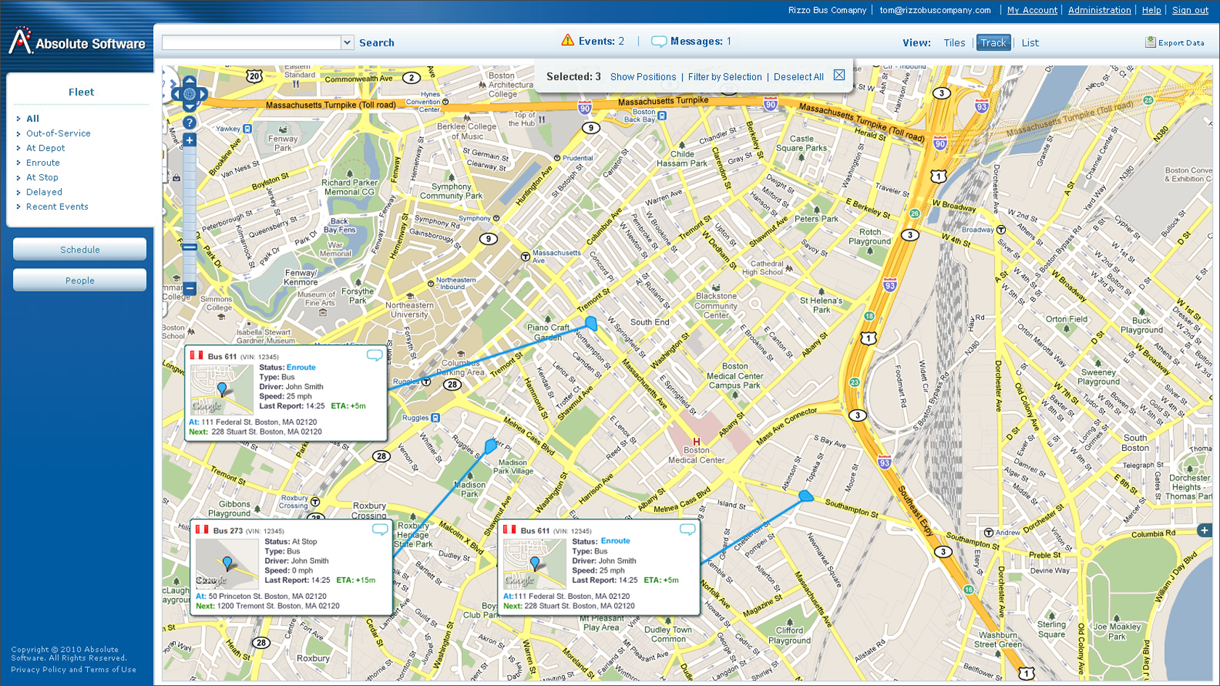
Mapping, Tracking and Routing

Slide 12
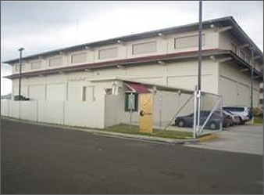
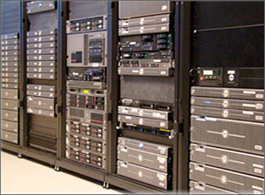
Reliable and Secure Hosting
The Absolute Fleet Monitoring Data Center processes all GPS position reports, sensors and messages within a high availability environment – including strong security and privacy safeguards.
Absolute operates three server clusters for redundancy (United States, Australia and Panama). Fault tolerance is achieved through the use of replicated HP Servers, EMC Storage, VMWare Virtualization and Sonicwall firewalls
All client data is available for integration with internal systems (i.e. ERP systems, Logistics, Dispatch or Maintenance Scheduling).
The available web-services interfaces include:
Excel/CSV
WSDL/XML
KML (Google Earth)
Json

Slide 13
Thank You
For further information please contact us at: sales@absolutesw.com
North American Office
Absolute Software, Inc.
19th Floor
101 Federal Street
Boston, MA 02110
United States
Tel: + 1 617 800-9367
Asia/Pacific Office
Absolute Software, Inc.
Level 9, Zuellig House Building
1 Silom Road,
Kwaeng Silom, Khet Bangrak,
Bangkok 10500 Thailand
Tel: +66 2231-8249
Panama Office
Absolute Maritime Tracking Services, S.A.
City of Knowledge, No 221
Panama, Republic of Panama
Tel: +507 301-5748
Australian Office
Absolute Software PTC
Level 36 Riparian Plaza
71 Eagle Street
Brisbane QLD 4000
Australia
Tel: +61 7 3121-3079
Visit us online at: www.absolutesw.com

