Slide 1
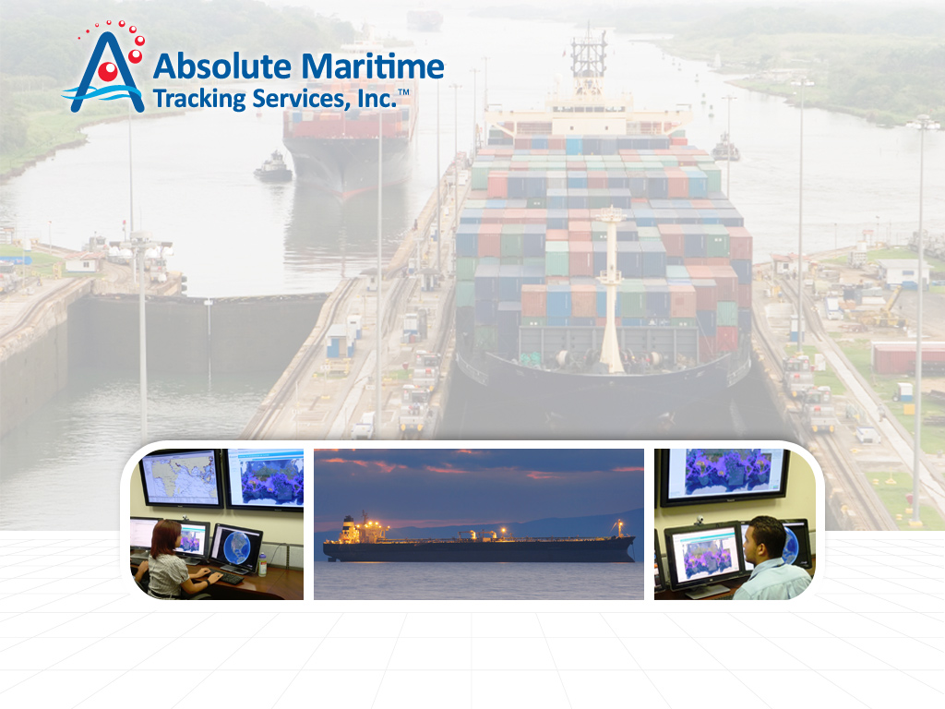
Long Range Identification & Tracking

Slide 2
Absolute Maritime Tracking Services
Founded in 2008 by PSC Holdings and Absolute Software Inc
Holds over $12M in LRIT contracts, including the National LRIT Data Center for Panama (the world’s largest)
Headquartered in the City of Knowledge Technology Park in Panama City with additional offices located in the United States, Australia and Asia. AMTS customers are further supported by a network of over 50 authorized agents worldwide
AMTS offers a full range of LRIT services to flag, coastal and port administrations –enabling our clients to meet their SOLAS obligations
AMTS is introducing a companion service for commercial shipowners with several unique features based on our LRIT experience, including fleet tracking, voyage following, safety and anti-piracy tools

Slide 3
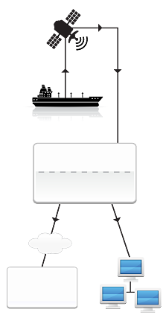
The LRIT Network
Communications
Satellite
Provider
LRIT is required by SOLAS Chapter V Regulation 19-1
The regulation is applicable to most ships >300 GRT (when engaged on an international voyage)
Technical standards for the system are published by the Maritime Safety Committee of the International Maritime Organization as resolution MSC.263(84)
LRIT Operation commenced 1-Jan-2009
(with phased deployment through to 30-Jun-2010)
Flag States have primary responsibility for monitoring their ships, and are required to share the LRIT position data with other coastal/port states in accordance with the SOLAS Convention
SOLAS Class Ship
Application Service Provider
Data Center
IDE
Port/Coastal
States
Flag State Registry

Slide 4
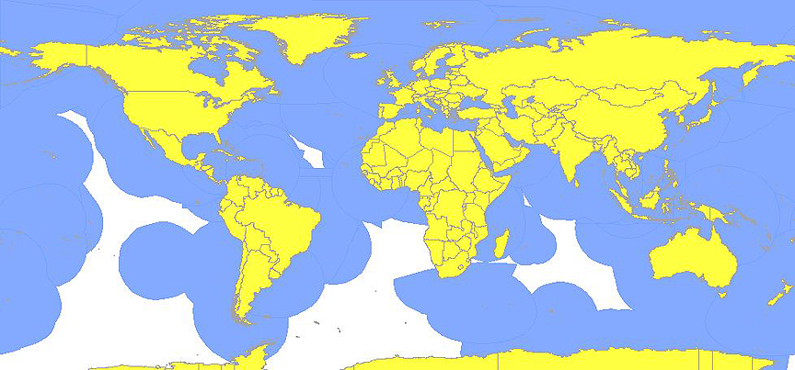
LRIT Network Coverage
Coastal Administrations can track ships up to 1,000 nautical miles from their coastline
(blue areas indicate the extent of 1000nm polygons for current LRIT participants)
Port Administrations can track ships at any distance (following a notice-of-port-call)

Slide 5
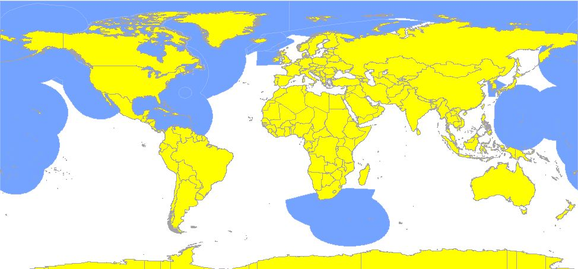
LRIT Network Coverage
Standing orders (requests for LRIT data forwarding) as of October 2010
LRIT positions are automatically forwarded to the coastal administrations shown

Slide 6
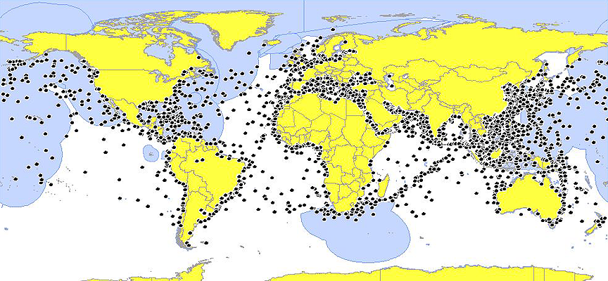
LRIT Network Coverage
An estimated 30,000 ships are tracked daily on the LRIT Network
Over 6,000 of these are monitored by Absolute Maritime Tracking Services (as shown)

Slide 7

LRIT for Flag Administrations
Application Service Provider
National Data Center Operator
24 x 7 Operations Center
The Fleet Information System

Slide 8
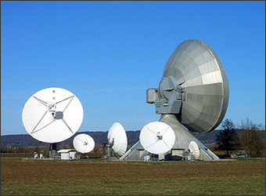
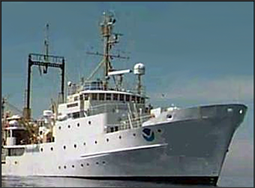
Application Service Provider
The Application Service Provider (ASP) receives position data and coordinates reported by shipboard equipment
We provide a full range of services both as the Recognized ASP and Testing ASP for LRIT Conformance Testing
Our ASP is compatible with all major makes/models of LRIT shipboard equipment on both Inmarsat and Iridium
Each Shipboard Device is thoroughly tested before use, via an automated Conformance Testing procedure
Ships Registered by AMTS | 8,248
Successful Conformance Tests | 7,185
Commands to Shipboard Equipment | 250,000+
Average Daily Position Reporting | 22,000+
Total LRIT Positions Received | 10,000,000+

Slide 9
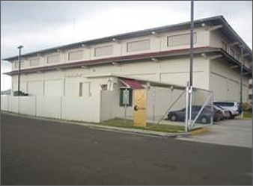
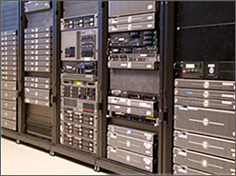
LRIT National Data Center
The Datacenter processes LRIT position reports to determine which reports are forwarded to other Coastal/Port administrations via the International Data Exchange (IDE)
We operate three server clusters for redundancy (Panama, The United States and Australia). All infrastructure exceeds the requirements of the IMO Technical Specifications. Fault tolerance is achieved through the use of replicated HP Servers, EMC Storage and VMWare Virtualization
All Datacenters within the LRIT Network are audited annually by the International Maritime Satellite Organization - to confirm they are operating in compliance with the LRIT Regulations
Sonicwall Firewall products.
Average positions forwarded daily | 4,200
Total positions forwarded via IDE | 900,000+
Average Number of Ships Reporting | 6,000+
Countries requesting LRIT Data | 24

Slide 10
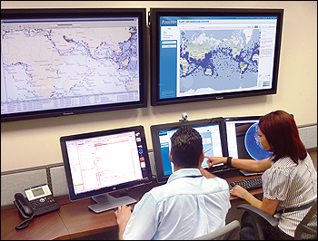
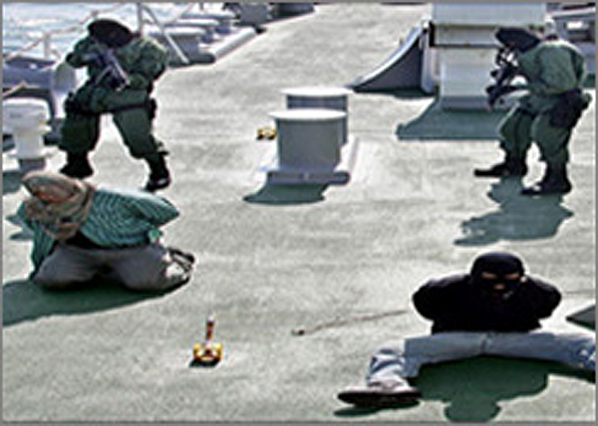
24 x 7 Operations Center
Our Monitoring, Control and Surveillance center is staffed by trained duty officers
The center is manned twenty-four hours a day, seven day a week, every day of the year
We provide real-time support to flag administrations and multinational forces engaged in combating piracy -including data feeds in military tactical (C2/C4) formats
Our operations team also provides live support to shipowners, port states (in relation to inspections) and surveyors (for queries regarding LRIT Conformance Tests)
Measured System Availability | 99.67%
Number of 24x7 Duty Officers | 6
Search & Rescue Positions Sent | 9,000+
Realtime Piracy Alert Responses | 15+

Slide 11
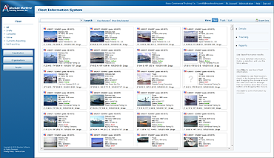
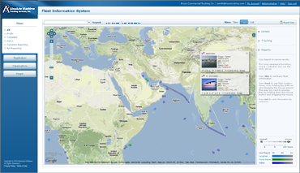
The Fleet Information System
A Complete Web Based Monitoring Solution
Compatible with all major browsers including Internet Explorer, Firefox, Chrome and Safari. Features include:
  Ship Registration Details
  Photos/Documents
  Position Data
  Voyage Capture and Trip Reporting
2D and 3D visualization tools provide an integrated view of the ship’s activity, location and past voyages
Configurable Alarms include:
  Entry/Exit to port
  Entry into high piracy risk areas
  Unexpected slowdown at-sea
  Faulty or non-reporting LRIT Equipment
The User Interface for the LRIT System

Slide 12
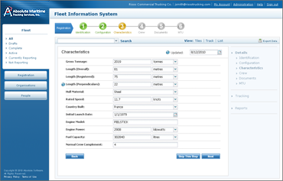
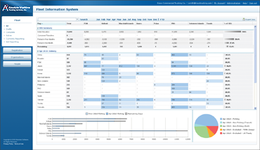
Security & Access Types
Flag (full access to all ships under flag)
Shipowner
(access restricted to their own ships)
Surveyors
(restricted access to verify conformance tests)
Agents or Charterers
(selective access when granted by shipowner)
Coastal/Port Administrations
(enhanced LRIT information and reports)
Piracy Prevention Taskforces
(automated OTH-GOLD tactical feed)
The User Interface for the LRIT System

Slide 13
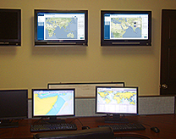
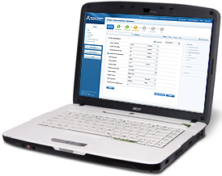
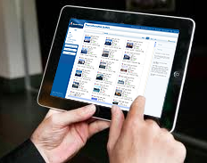
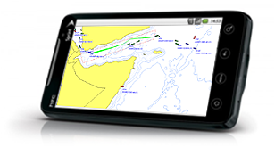
User Interface Platforms
Monitoring Console
Laptop
Tablet
Smart Phone

Slide 14




Compatible Satellite Service Providers
Inmarsat is an internationally recognized pioneer in the satellite communication industry. Within the LRIT network the majority of ships currently use either the Inmarsat-C network or Inmarsat IsatM2M network.
Iridium is the world’s only truly global mobile satellite communications company. Iridium is particularly suited to LRIT coverage in sea area A4 (the polar regions). Absolute is an authorized Iridium Value Added Reseller.
Stratos is a leader in delivering vital voice, data and IP communications. We source Inmarsat airtime through Stratos as one of our preferred Communications Service Providers for LRIT.
Vizada is a leading independent satellite communications provider. We source Inmarsat airtime from Vizada as one of our preferred Communications Service Providers for LRIT.

Slide 15
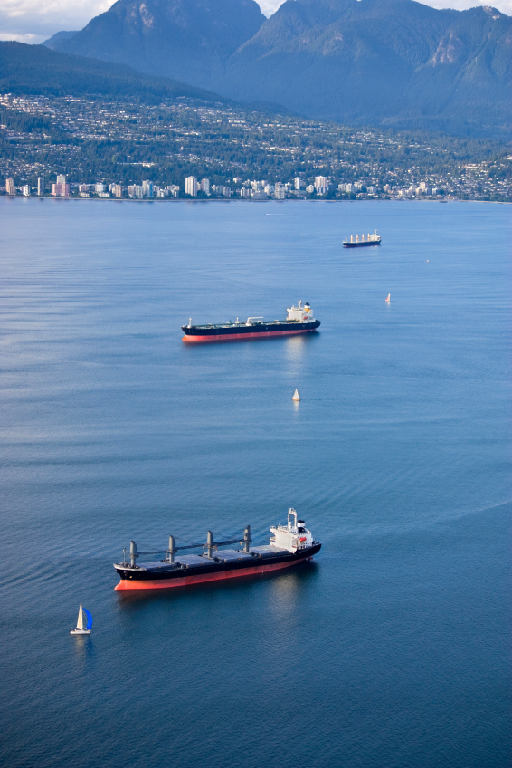
LRIT for Shipowners
Conformance Testing
Fleet Tracking Services
Ship Security Alert System (SSAS)

Slide 16
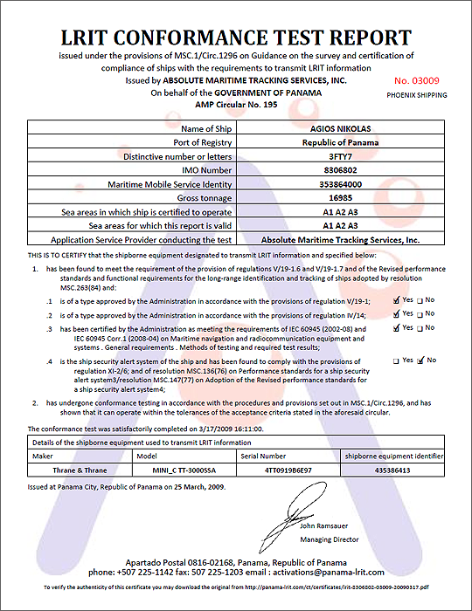
Conformance Testing
We are one of the largest three LRIT Conformance Test Providers. All operations are conducted in accordance with an ISO-9001 quality assured process
Our service includes a unique Data Accuracy Crosscheck that verifies the details submitted by the shipowner with those recorded within ESAS (Inmarsat), SEA‐WEB, EQUASIS and MARS
We provide 24 x 7 support to Surveyors and Port Administrations - including on-line access to Conformance Test Reports (from 2011 onwards)
Worldwide Agents | 50+
Conformance Tests Performed | 7,200+
Percentage of Equipment Passed | 85%
Average time to Complete Test | 48 hrs

Slide 17

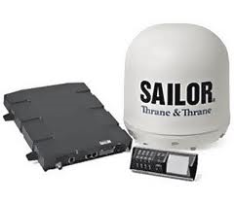
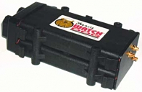
Compatible Shipboard Equipment
Inmarsat-C
  JRC
  Furuno Felcom
  Thrane & Thrane
  Sailor
  …over 150 makes/models tested
IsatM2M (D+)
  Skywave Mobile
  EMS Global
  (formerly Satamatics)
Iridium
  Faria Watchdog
  CLS Thorium
  EMA BlueTracker
Future Type Approvals
  Fleet Broadband
  Iridium OpenPort
  VSAT Equipment

Slide 18
Fleet Tracking Services for Shipowners
Shipowners who are monitored via an AMTS Datacenter now have the option to access to LRIT position reports for their own ships*
The system is secure - only the recognized owner pursuant to ISPS may request access. All data is protected within a secure database and encrypted with the industry standard HTTPS protocol during web access
Each shipowner may grant access to other parties (such as charterers or agents) including placing restrictions on the duration and scope of access
A full range of tracking, reporting and alert functions are available to shipowners - including email notification if LRIT equipment ceases to report properly
Further details are available within the Fleet Information System brochure
*where approved by the Flag Administration

Slide 19

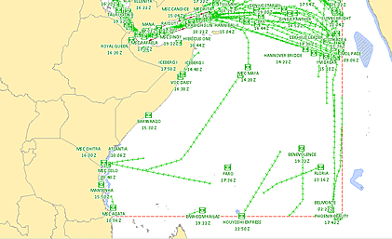
Ship Security Alert System
SSAS provides a secure ‘panic button’ in case of piracy or other security related incident
We meet all IMO requirements to act as a Competent Authority on the behalf of the shipowner
SSAS alerts are handled through our permanently staffed 24x7 response center – using the same trained staff who operate the LRIT system on behalf of Flag Administrations
A unique feature of our solution is that we combine SSAS+LRIT to proactively monitor ship behavior at-sea, then alert on entry to high risk areas or when a ship exhibits unexpected behavior such as stopping suddenly at sea

Slide 20
Conclusion
LRIT is a complex Mission Critical system with a high transaction volume, multiple users worldwide and systems from several suppliers that must interoperate for LRIT to function correctly
The AMTS solution for LRIT is uniquely suited to management of very large fleets – and offers much more than the basic ‘tracking-only’ application offered by competitors
Our Fleet Information System includes a powerful Geographic Information System (GIS) performing geospatial analysis over large volumes of data. Several enhanced features require this capability; including piracy warnings, trip following and the configurable zones and alarms that our alerting system offers
User Friendly Interface – entirely web based (no plugins required)
AMTS has achieved a measured uptime of 99.67% on all LRIT operations since commencement. On this basis we believe we offer the most reliable and dependable solution in the marketplace

Slide 21
Thank You
For further information please contact us at: sales@absolutemaritime.com
Headquarters
Absolute Maritime Tracking Services, S.A.
City of Knowledge, No 221
Panama, Republic of Panama
24 Hour Telephone: + 507 301-5748
Asia/Pacific Office
Absolute Software, Inc.
Level 9, Zuellig House Building
1 Silom Road,
Kwaeng Silom, Khet Bangrak,
Bangkok 10500 Thailand
Tel: +66 0 2231-8249
USA Office
Absolute Software, Inc.
19th Floor
101 Federal Street
Boston, MA 02110
United States
Tel: + 1 617 800-9367
Australian Office
Absolute Software PTC
Level 36 Riparian Plaza
71 Eagle Street
Brisbane QLD 4000
Australia
Tel: + 61 4 1218-1917
Visit us online at: www.absolutemaritime.com

Slide 22
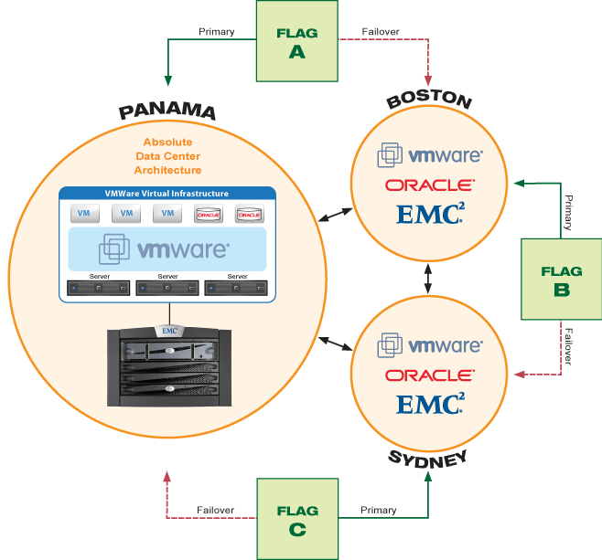
LRIT Datacenter - Fault Tolerant Architecture

